Slide 1
Big-O Notation
INFO-3135

Slide 2
Big O Notation
Big O notation is used in Computer Science to describe the performance or complexity of an algorithm.
Big O specifically describes the worst-case scenario, and can be used to describe the execution time required or the space used (e.g. in memory or on disk) by an algorithm.
Anyone who doesn’t have a grounding in Mathematics will hit a wall when they reached mention of O(N log N) or other seemingly crazy syntax.
The best way to understand Big O thoroughly is to examine some examples in code.
We will look at some common orders of growth along with descriptions and examples where possible

Slide 3
Big O Notation
O(1)
O(1) describes an algorithm that will always execute in the same time (or space) regardless of the size of the input data set.
bool IsFirstElementNull(IList<string> elements)
{
return elements[0] == null;
}

Slide 4
Big O Notation
O(N)
O(N) describes an algorithm whose performance will grow linearly and in direct proportion to the size of the input data set. The example below also demonstrates how Big O favours the worst-case performance scenario; a matching string could be found during any iteration of the for loop and the function would return early, but Big O notation will always assume the upper limit where the algorithm will perform the maximum number of iterations.
bool ContainsValue(IList<string> elements, string value)
{
foreach (var element in elements)
{
if (element == value) return true;
}
return false;
}

Slide 5
Big O Notation
O(N²)
O(N²) represents an algorithm whose performance is directly proportional to the square of the size of the input data set. This is common with algorithms that involve nested iterations over the data set. Deeper nested iterations will result in O(N³), O(N⁴) etc.
bool ContainsDuplicates(IList<string> elements){
for (var outer = 0; outer < elements.Count; outer++){
for (var inner = 0; inner < elements.Count; inner++)
{ // Don't compare with self
if (outer == inner) continue;
if (elements[outer] == elements[inner]) return true;
}
}
return false;
}

Slide 6
Big O Notation
O(2^N)
O(2^N) denotes an algorithm whose growth doubles with each addition to the input data set. The growth curve of an O(2^N) function is exponential - starting off very shallow, then rising meteorically. An example of an O(2^N) function is the recursive calculation of Fibonacci numbers:
int Fibonacci(int number)
{
if (number <= 1) return number;
return Fibonacci(number - 2) + Fibonacci(number - 1);
}

Slide 7
Logarithms
A Binary search is a technique used to search sorted data sets. It works by selecting the middle element of the data set, essentially the median, and compares it against a target value.
If the values match it will return success.
If the target value is higher than the value of the probe element it will take the upper half of the data set and perform the same operation against it.
Likewise, if the target value is lower than the value of the probe element it will perform the operation against the lower half.
It will continue to halve the data set with each iteration until the value has been found or until it can no longer split the data set.
This type of algorithm is described as O(log N)

Slide 8
O(log N)
The iterative halving of data sets described in the binary search example produces a growth curve that peaks at the beginning and slowly flattens out as the size of the data sets increase
e.g. an input data set containing 10 items takes one second to complete, a data set containing 100 items takes two seconds, and a data set containing 1000 items will take three seconds.
Doubling the size of the input data set has little effect on its growth as after a single iteration of the algorithm the data set will be halved and therefore on a par with an input data set half the size.
This makes algorithms like binary search extremely efficient when dealing with large data sets.

Slide 9
Big O Notation another Perspective
O(n)
Linear time
An algorithm with complexity T(n) = n -1.
Using Big O notation this can be written as T(n) ∊ O(n).
An algorithm with T(n) ∊ O(n) is said to have linear time complexity.

Slide 10
Big O Notation
O(n²)
Quadratic time
An algorithm with time complexity of T(n) = n2/2 - n/2.
With Big O notation, this becomes T(n) ∊ O(n²), and we say that the algorithm has quadratic time complexity.

Slide 11
Big O Notation
Linear vs Quadratic

Slide 12
Big O Notation
Linear vs Logarithmic

Slide 13
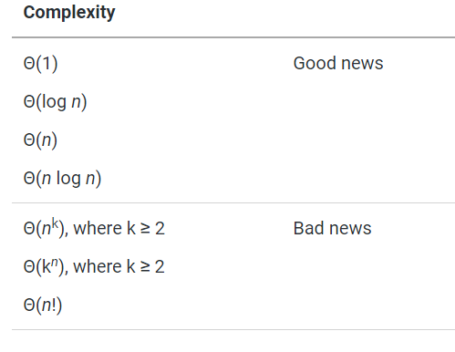
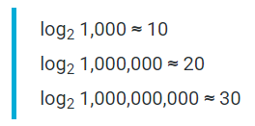
Big O Notation
When analyzing algorithms you often come across the following time complexities.
O(n log n) is really good
The first four complexities indicate an
excellent algorithm. An algorithm with
worst-case time complexity
W(n) ∊ O(n log n) scales very well,
since logarithms grow very slowly.

Slide 14
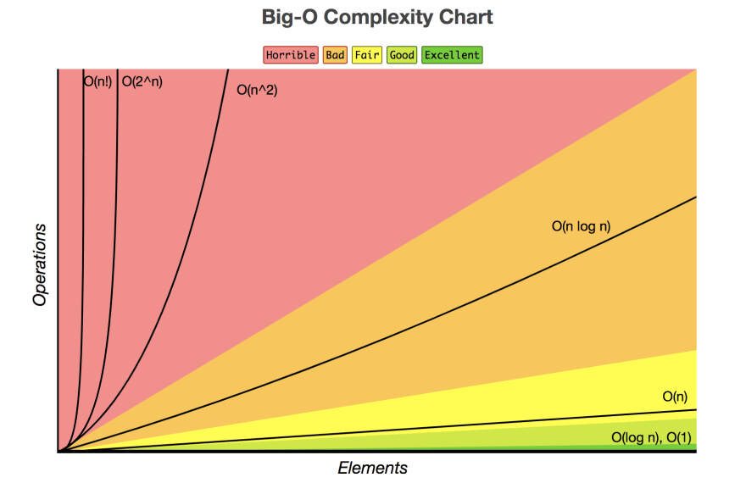
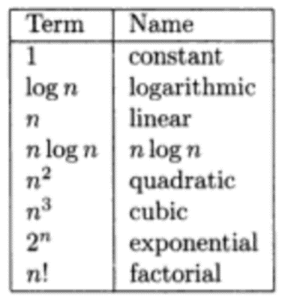
Big O Notation

Slide 15
Calculating Big O
It's as easy as following along with your code and counting along the way
Begin with a simple loop to calculate the sum of numbers in an array:
for (i = sum = 0; i < n; i++)
sum += a[i];
First, two variables are initialized, then the for loop iterates n times, and during each iteration, it executes two assignments, one of which updates sum and the other of which updates i.
Thus, there are 2 + 2n assignments for the complete run of this for loop
complexity is O(n).

Slide 16
Calculating Big O
Complexity usually grows if nested loops are used, as in the following code, which outputs the sums of all the subarrays that begin with position 0:
for (i = 0; i < n; i++) {
for (j = 1, sum = a[0]; j <= i; j++)
sum += a[j];
cout<<”sum for subarray 0 through “<< i <<” is “<<sum<<end1;
}
Before the loops start, i is initialized. The outer loop is performed n times, executing in each iteration an inner for loop, print statement, and assignment statements for i, j, and sum.
The inner loop is executed i times for each i ∈ {1, . . . , n – 1} with two assignments in each iteration: one for sum and one for j.
Therefore, there are 1 + 3n + Σn–1 i=1 2i = 1 + 3n + 2(1 + 2 + · · · + n – 1) = 1 + 3n + n(n – 1) = O(n) + O(n²) = O(n²) assignments executed before the program is completed

Slide 17
Calculating Big O
Algorithms with nested loops usually have a larger complexity than algorithms with one loop, but it does not have to grow at all. For example, we may request printing sums of numbers in the last five cells of the subarrays starting in position 0. We adopt the foregoing code and transform it to
for (i = 4; i < n; i++) {
for (j = i-3, sum = a[i-4]; j <= i; j++)
sum += a[j];
cout<<”sum for subarray “<<i-4<<” through “<< i <<” is “”<<sum<<end1;
}
The outer loop is executed n – 4 times.
For each i, the inner loop is executed only four times; for each iteration of the outer loop there are eight assignments in the inner loop, and this number does not depend on the size of the array.
With one initialization of i, n – 4 increments of i, and n – 4 initializations of j and sum, the program makes 1 + 8 • (n – 4) + 3 • (n – 4) = O(n) assignments.

